Slide 1

Cybersecurity Intrusion Detection
Using supervised machine learning techniques
Submitted by,
Dhanya Varghese
Data Analyst
Techolas Technologies
Submitted to,
Akhila
Techolas Technologies

Slide 2


Introduction
Cybersecurity is essential to protect systems, networks, and data from unauthorized access and cyber threats. With the rise in cyberattacks, automated and intelligent threat detection is more important than ever.
This project applies machine learning to detect cyber intrusions by analyzing network traffic and user behavior patterns.

Slide 3

The dataset consists of network-based and user behavior-based
features. Each feature provides valuable information about potential cyber threats.
Network-Based Features
network_packet_size (Packet Size in Bytes)
protocol_type (Communication Protocol)
encryption_used (Encryption Protocol)
User Behavior-Based Features
login_attempts (Number of Logins)
session_duration (Session Length in Seconds)
failed_logins (Failed Login Attempts)
unusual_time_access (Login Time Anomaly)
ip_reputation_score (Trustworthiness of IP Address)
browser_type (User’s Browser)
Target Variable (attack_detected)

Slide 4
WHY THIS PROJECT
Rising frequency and sophistication of cyberattacks demand smarter defense mechanisms.
Traditional rule-based intrusion detection systems are limited and often outdated.
Machine learning can detect complex and previously unseen patterns of intrusion.
Early detection of malicious activity can prevent severe data breaches and financial loss.
Builds practical skills in data analysis, cybersecurity, and ML model development.

Slide 5

DESIGN OF WEBSITE
Purpose: The project aims to detect cyber intrusions by analyzing network traffic and user behavior to identify potential security threats in real time.
Front End (Gradio): A user-friendly Gradio interface allows users to input relevant network-based and user behavior features to predict intrusion attempts easily.
User Inputs:
Network-Based Features: Network packet size (in bytes), protocol type, and encryption used.
User Behavior-Based Features: Number of login attempts, session duration (in seconds), failed login attempts, unusual time access, IP reputation score, and user’s browser type.
ML Models Used: Random Forest, XG-Boost, SVC, Logistic Regression were employed to build robust and accurate intrusion detection classifiers.

Slide 6
PROCESS OF DATASET
Data Collection Gather network traffic and user behavior data related to cybersecurity intrusions from reliable sources.
Data Cleaning Handle missing values, and correct any inconsistencies to ensure data quality.
Data Preprocessing Convert categorical variables into numerical formats, normalize features, and prepare the dataset for modeling.
Feature Selection Identify the most relevant features like login attempts, session duration, IP reputation, and encryption used to improve model performance.
Model Selection Choose suitable machine learning algorithms such as Random Forest, XG-Boost, SVC, Logistic Regression to build effective intrusion detection models.
Model Training and Evaluation Train models on the processed data, and evaluate performance using metrics like accuracy and recall.

Slide 7
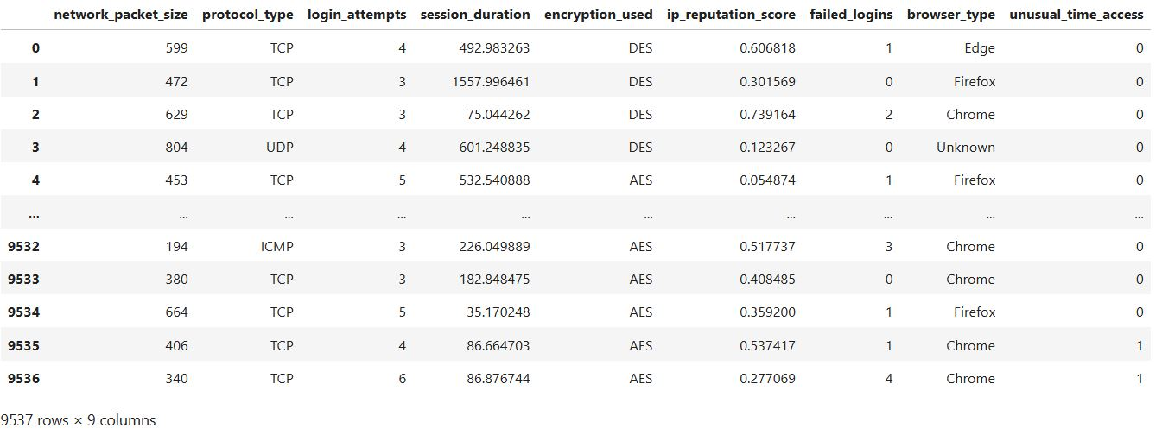
DATASET

Slide 8
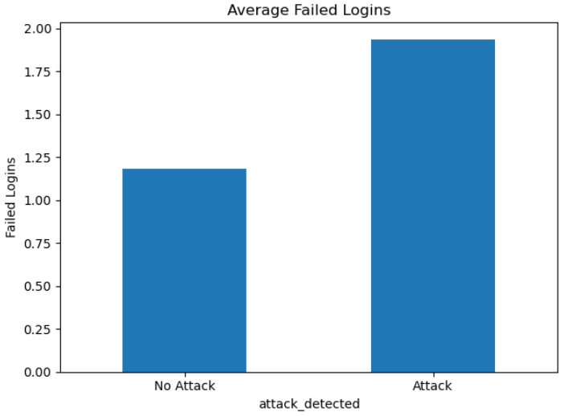
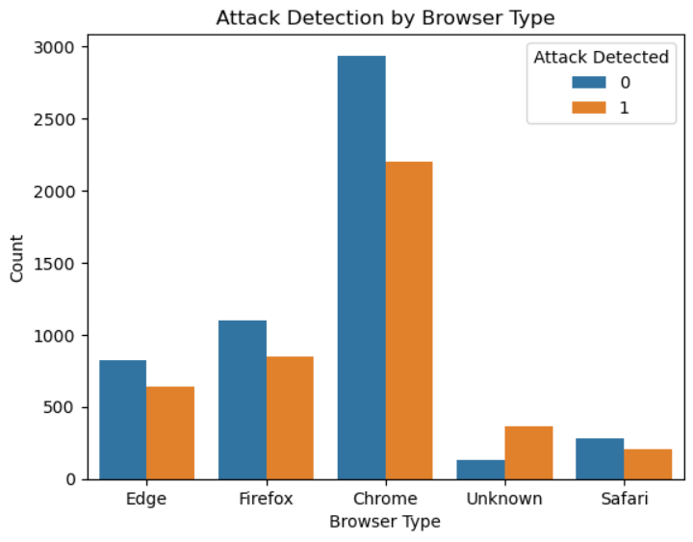
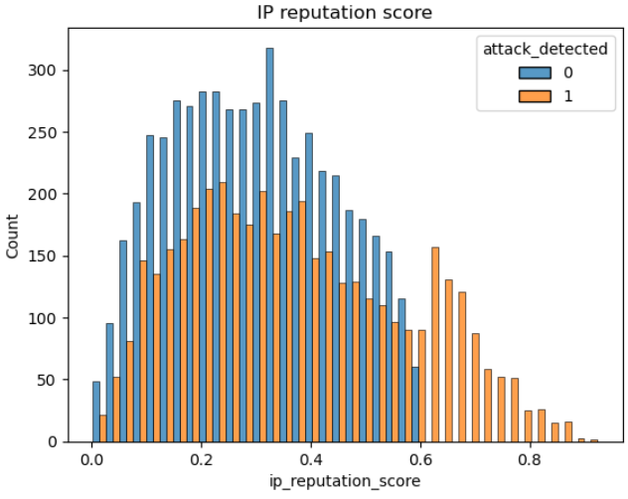
GRAPHICAL OVERVIEW

Slide 9
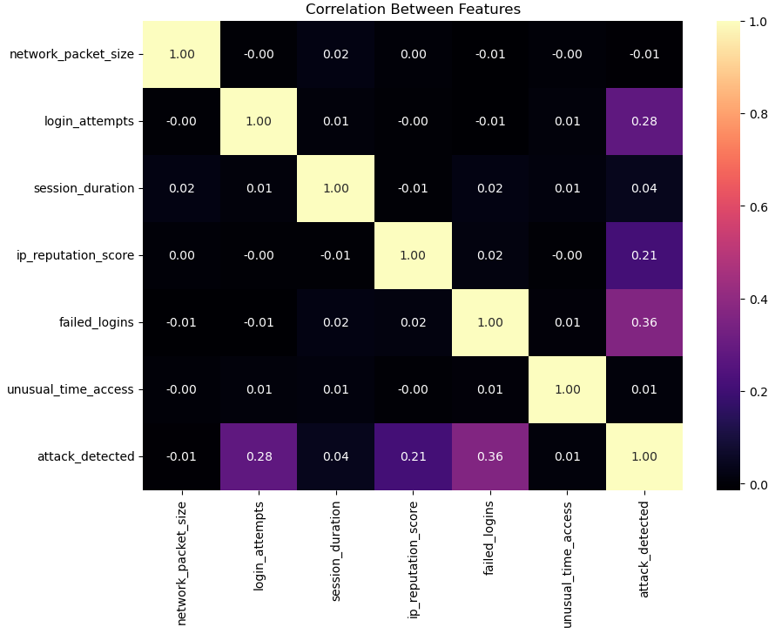

Slide 10
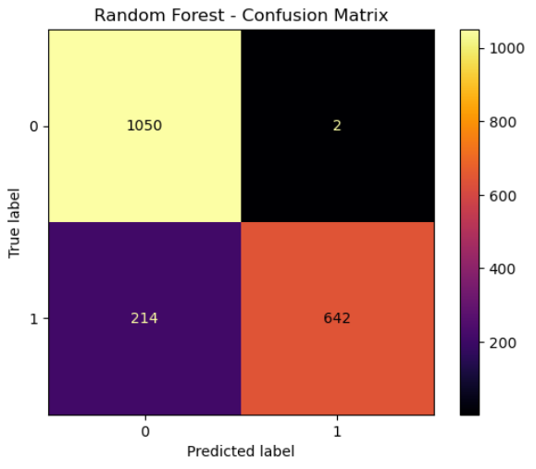
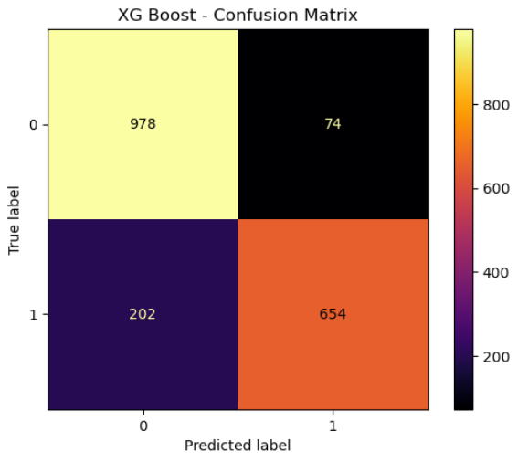
GRAPHICAL OVERVIEW
RANDOM FOREST
XG BOOST

Slide 11
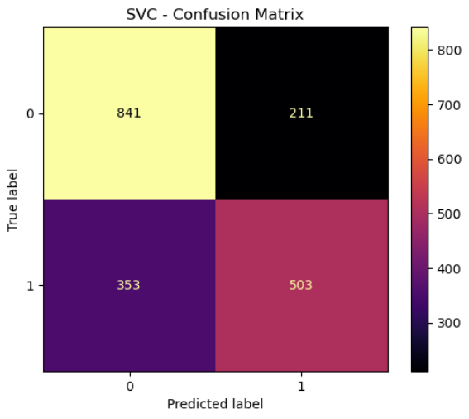
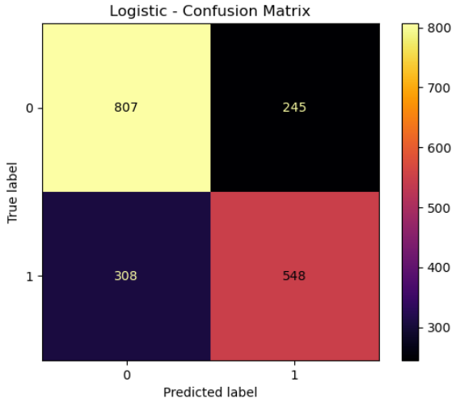
GRAPHICAL OVERVIEW
SVC
LOGISTIC REGRESSION

Slide 12

FUTURE IMPROVEMENTS
Real-Time Detection System - Integrate the model into a live system that monitors real-time network traffic for instant intrusion alerts.
Expanded Feature Set - Include additional features such as geolocation, device fingerprinting, or historical user patterns for better accuracy.
Automated Threat Response - Connect the detection system with automated security actions like blocking IPs or alerting admins.
Explainability & Transparency - Add model explainability tools (e.g., SHAP, LIME) to help security analysts understand why a prediction was made.
Multi-Class Classification - Extend the model to classify the type of intrusion (e.g., DoS, phishing, brute-force) instead of just binary detection.
Deployment on Edge Devices - Deploy lightweight models on edge devices like firewalls or routers for faster, distributed detection.

Slide 13

KEY INSIGHTS AND FINDINGS
Behavior-based cyber threats are becoming more common and harder to detect using traditional methods.
Monitoring both user behavior and network-level data significantly improves intrusion detection accuracy.
Access from low-reputation IP addresses is strongly linked to malicious activity.
Unusual login times are a clear signal of potential unauthorized access.
The presence of encryption alone does not guarantee the traffic is safe.
The type of browser used can help identify suspicious or automated access attempts.
Effective cybersecurity relies on combining multiple layers of analysis for better threat visibility.

Slide 14

CONCLUSION
Good cybersecurity means looking at both network data and how users behave. Keeping track of things like login attempts, session length, failed logins, strange login times, IP trustworthiness, and encryption helps find unusual activity that could be an attack. Using all these details together helps organizations spot threats early and protect themselves better against new and tricky cyberattacks.

Slide 15
THANK YOU

